Slide 1
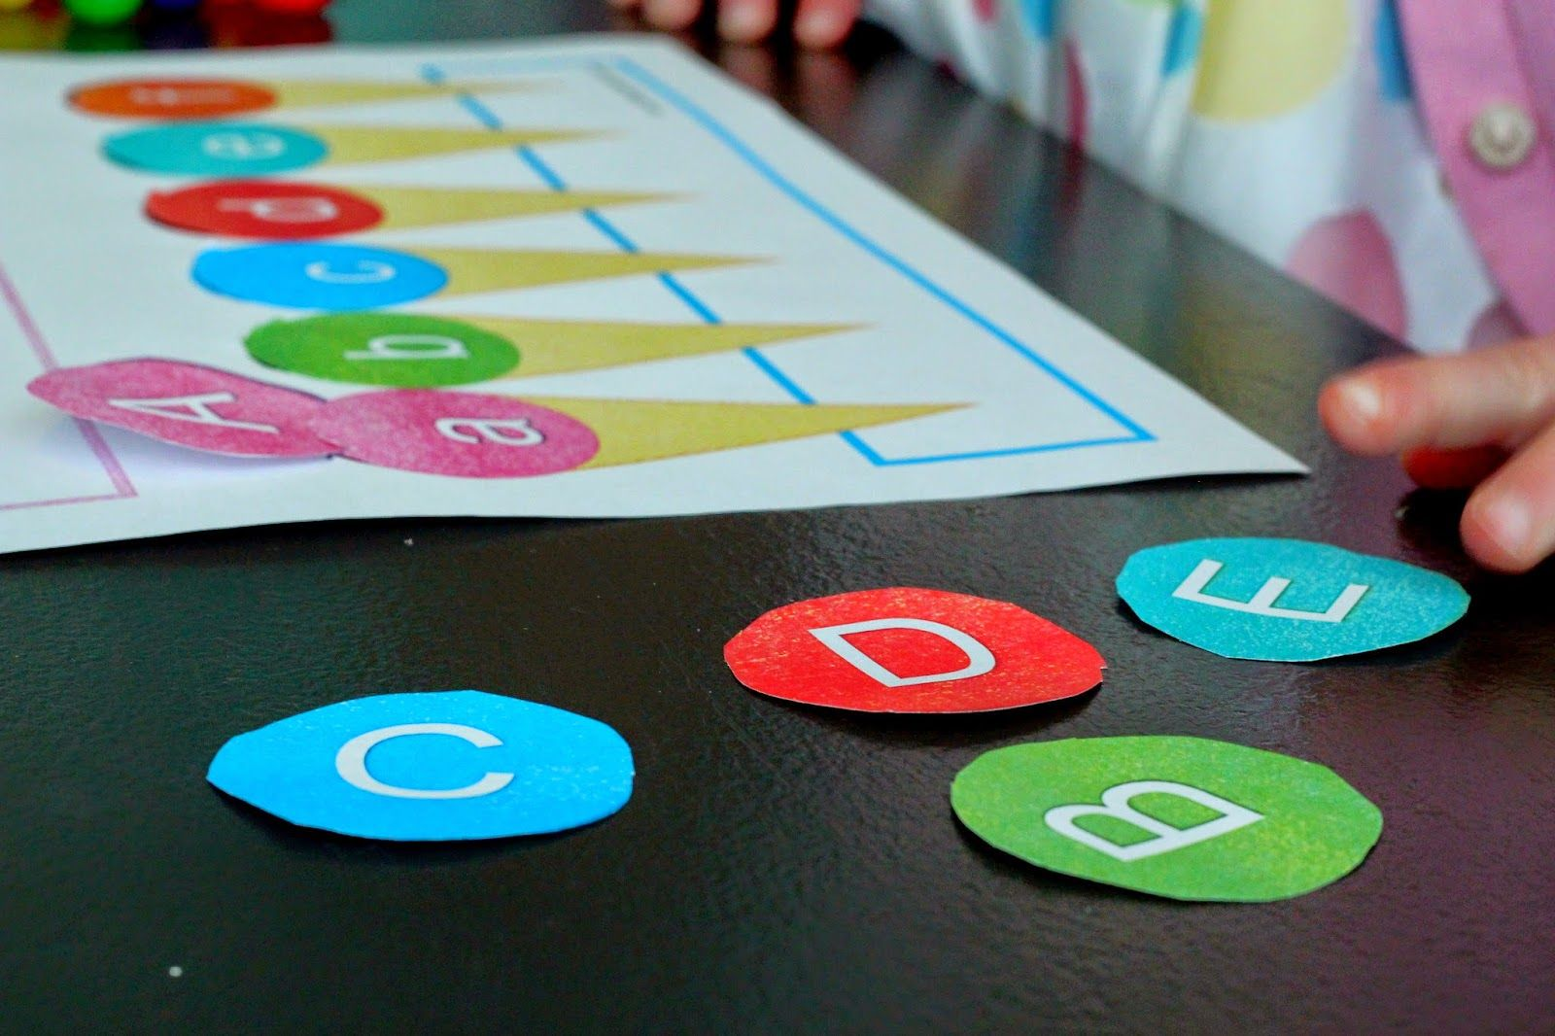
Linear Search Binary Search bubble sort
Presented by:
M.PALLAVI

Slide 2
Linear Search performs the searching and returns the position of the target element if it is present and otherwise returns a value of -1.
In fact, the loop within this function compares each element with the target until the target is found or the entire array is scanned.

Slide 3
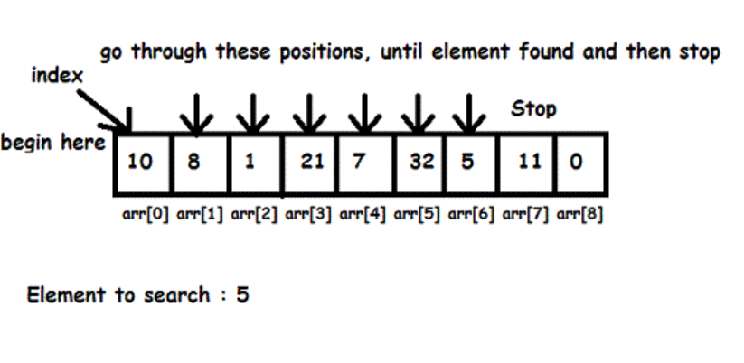

Slide 4
Program:
using System;
namespace ConsoleApplication1
{
class Program
{
static void Main(string[] args)
{
int i ;
int item;
int pos = 0;
int[] arr = new int[5];
//Read numbers into array
Console.WriteLine("Enter elements : ");
for (i = 0; i < arr.Length; i++)
{
Console.Write("Element {0}: ",i);
arr[i] = Convert.ToInt32(Console.ReadLine());
}

Slide 5
Console.WriteLine("Enter item to search ");
item = Convert.ToInt32(Console.ReadLine());
for (i = 0; i < arr.Length; i++)
{
if (item == arr[i])
{
pos = i + 1;
break;
}
}
if (pos == 0)
{
Console.WriteLine("Item Not found in array");
}
else
{
Console.WriteLine("Position of item in array: " + pos);
}
}
}
}

Slide 6
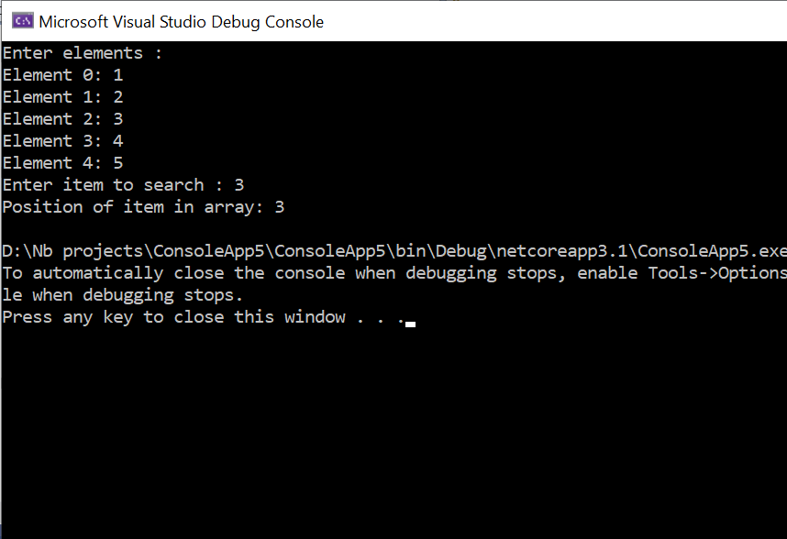

Slide 7
Binary search
using System;
namespace ConsoleApplication1
{
class Program
{
static void Main()
{ int i, item, pos=0;
int[] arr = new int[5];
int LOW=0, HIGH, MID;
//Read numbers into array
Console.WriteLine("Enter elements : ");
for (i = 0; i < arr.Length; i++)
{ Console.Write("Element {0}: ", i);
arr[i]=Convert.ToInt32(Console.ReadLine());
}
Console.Write("Enter item to search : ");
item = Convert.ToInt32(Console.ReadLine());
HIGH = arr.Length - 1;
MID = (LOW + HIGH) / 2;
}

Slide 8
//Loop to search element in array.
while (LOW <= HIGH)
{
if (item < arr[MID])
{
HIGH = MID - 1;
MID = (LOW + HIGH) / 2;
}
else if (item > arr[MID])
{
LOW = MID + 1;
MID = (LOW + HIGH) / 2;
}
else if (item == arr[MID])
{
pos = MID + 1;
break;
} }
if (pos == 0)
{
Console.WriteLine("Item Not found in array");
}
else
{
Console.WriteLine("Position of item in array:{0}”,pos);
} }
}

Slide 9
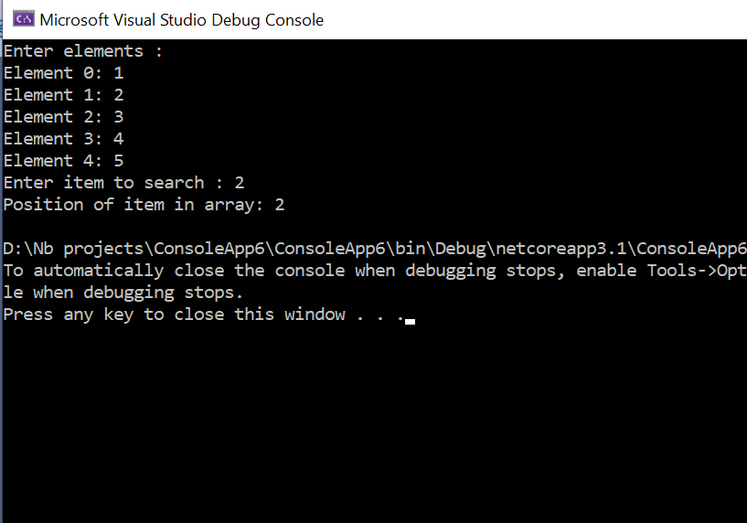

Slide 10
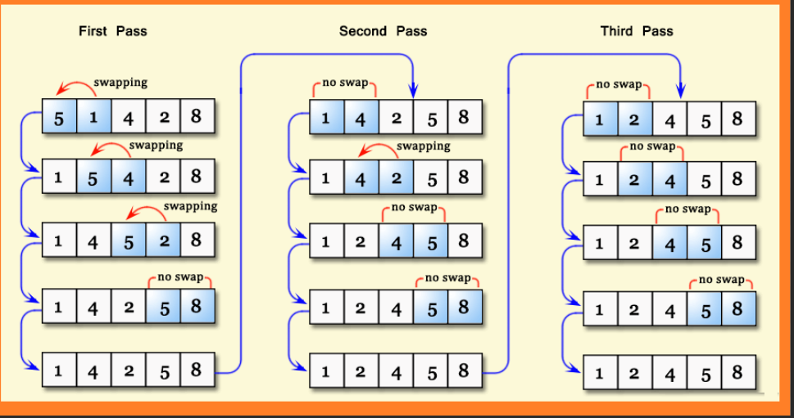
Bubble sort

Slide 11
Bubble sort
using System;
namespace Programs
{
class Program
{
static void Main(string[] args)
{
int count = 0;
int[] data= new int[5];
Console.WriteLine("Enter the Array Elements : ");
for (int i = 0; i < data.Length; i++)
{
data[i] =Convert.ToInt32(Console.ReadLine());
}
//Sorting the array
for (int j = 0; j <= data.Length - 2; j++)
{
for (int i = 0; i <= data.Length - 2; i++)
{
count = count + 1;

Slide 12
if (data[i] > data[i + 1])
{
int temp = data[i + 1];
data[i + 1] = data[i];
data[i] = temp;
}
}
}
Console.WriteLine("After Sorting Array :");
foreach (int item in data)
{
Console.WriteLine(item);
}
Console.ReadKey();
}
}

Slide 13
